Slide 1

The University of Toronto
DALLA Lana School of Public Health
Practicum Presentation
From Accelerometer Time Series to Functional Activity Features
Occupation Time Curves, AUC Construction, and Correlation Diagnostics
Presenter：Xiankai Yang
Instructor：Osvaldo Espin Garcia
Page 1

Slide 2
01
Background
02
Method
CONTENTS
03
Current Step
04
Future Arrange
Page 2

Slide 3


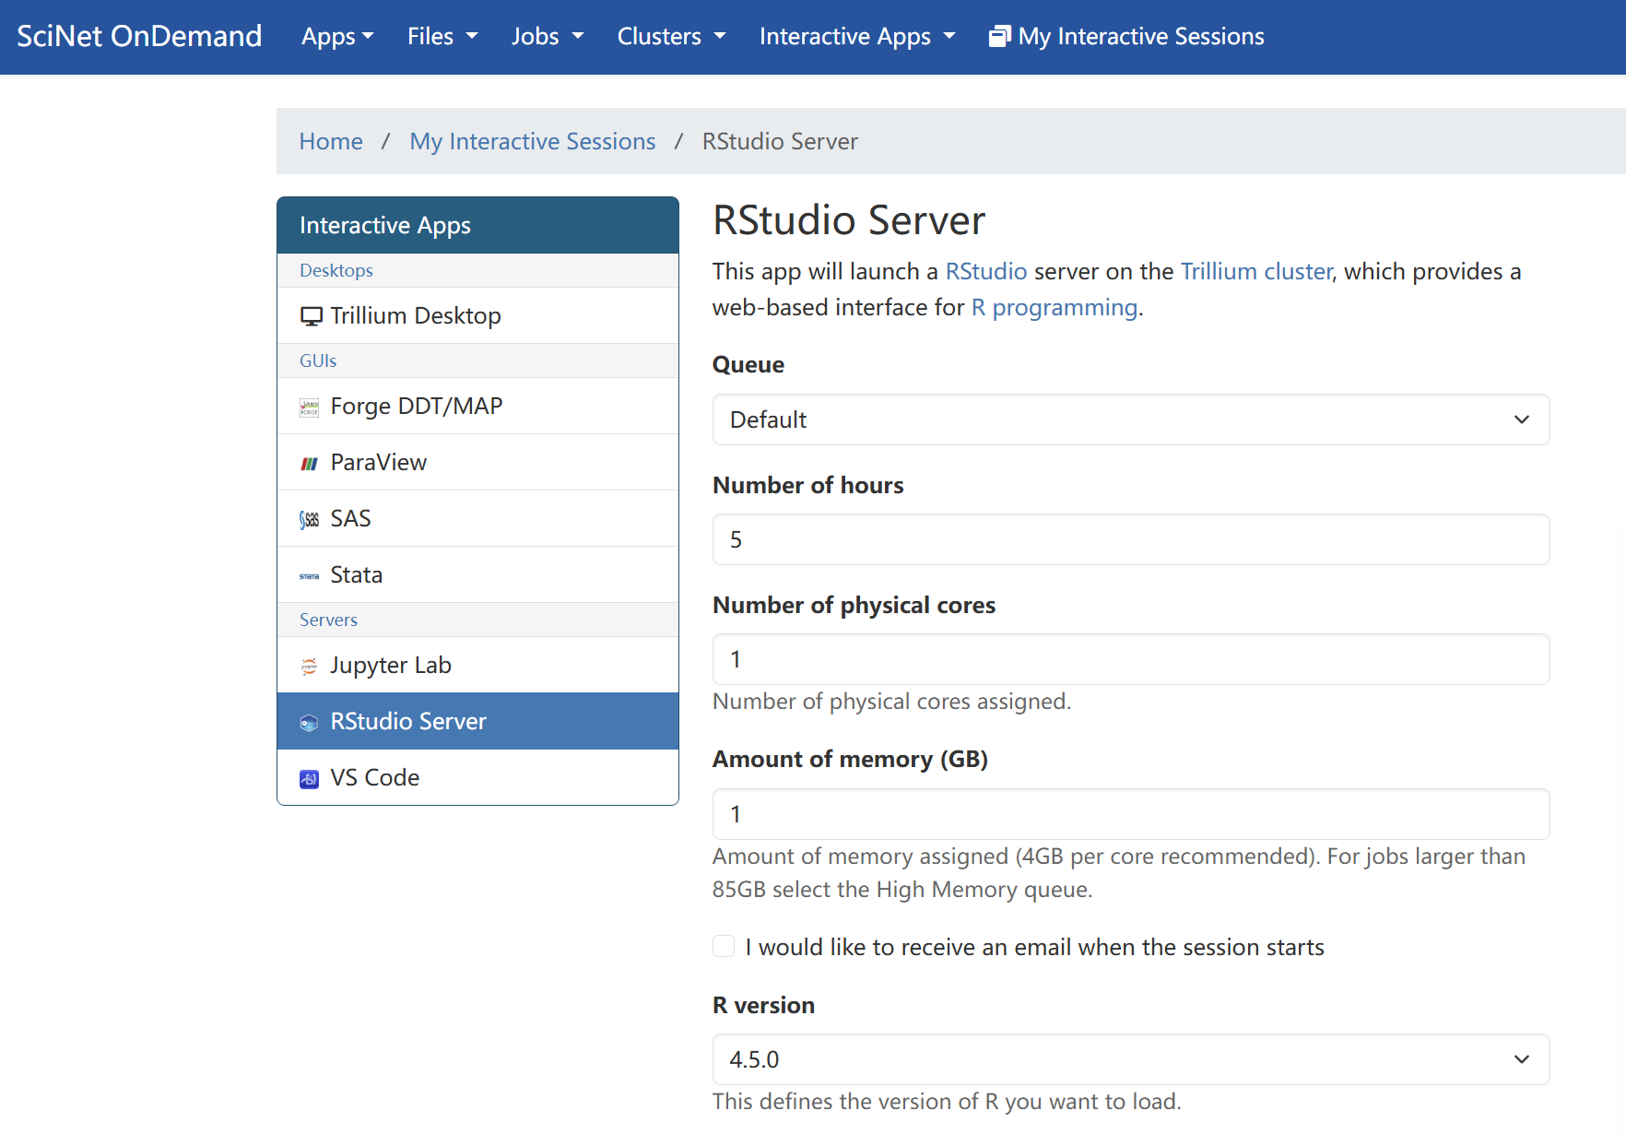

Part 1：Background
Computing Environment and Remote Access
1
Launch interactive sessions via a web browser
2
Run codes on remote compute nodes
3
Manage files and outputs within the same interface
Page 3

Slide 4


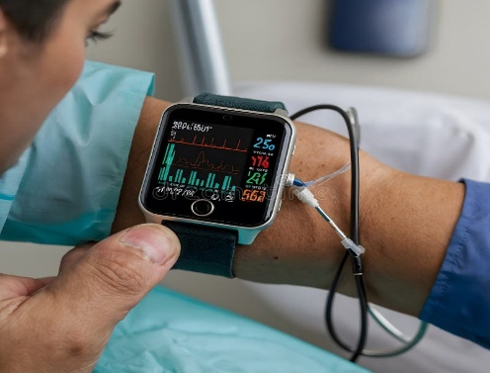

Part 1：Background
Dataset Overview
01
Data Source
02
Accelerometer Data
Osteoarthritis Initiative (OAI)
Large, longitudinal public health study
Data collected in the United States
Wearable accelerometer measurements
Minute-level physical activity counts
Multiple days per participant
Page 4

Slide 5
Part 1：Background
Variable Table
Variable | Type | Description
ID | Char | Same ID: same individual
V08PAStudayDay | Num | Study day (range 781–1427, with Day 1 = August 01, 2008)
V08MinSequence | Num | Time index (t): (range 1–1440, representing minutes from 00:00 to 23:59)
V08SupectMInute | Num | Indicator of suspicious minute suggesting monitor wear during sleep
V08MINCnt | Num | The core variable, which is the activity count
The primary variables used in subsequent analyses are V08MinSequence (time index) and V08MINCnt (activity count), which together form the minute-level activity time series for each individual.
Page 5

Slide 6
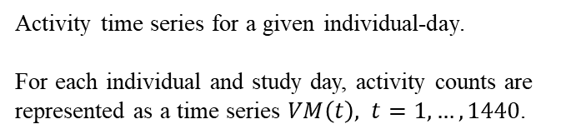
Part 2：Method
Scalar summary of the OTC.
The area under the OTC provides a low-dimensional summary of overall activity intensity.
Overall Process
Current Stage
Raw Data
VM(t)
OTC
AUC
Fused Lasso
Minute-level accelerometry data collected for each individual.
Raw activity counts recorded every minute across multiple study days.
Occupation Time Curve summarizing activity intensity distribution.
OTC captures the proportion of time the activity level exceeds a given threshold, discarding temporal ordering
Structure-aware regression on functional summaries.
Fused lasso encourages sparsity and smoothness across adjacent features.
L0 + MIO
Activity time series for a given individual-day.
For each individual and study day, activity counts are represented as a time series $VM\left(t\right), t=1,…,1440$.
Sparse variable selection via L0-regularized optimization.
Mixed-integer optimization is used to identify important activity features.
Page 6

Slide 7
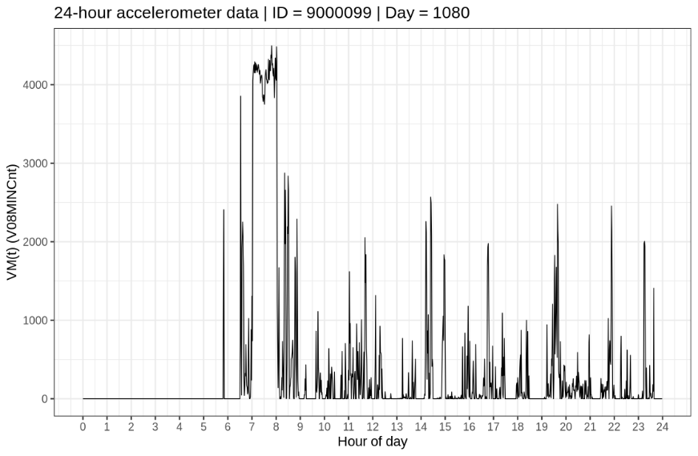
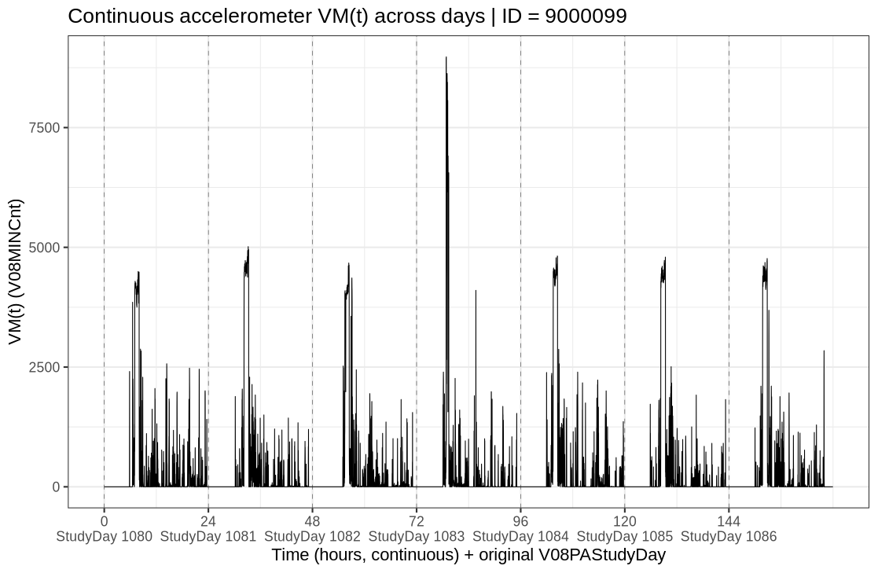
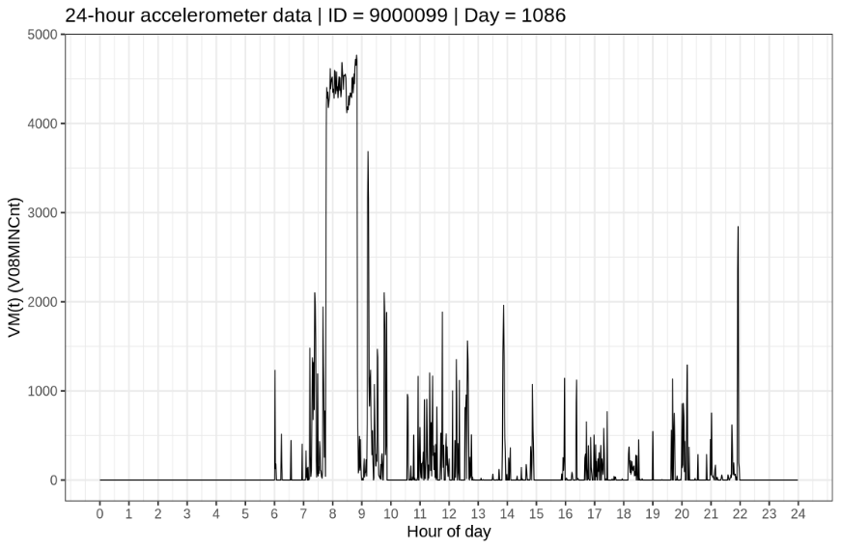
Part 3：Current Step
Build VM(t)
Vector Magnitude time series,
VM(t): minute-level activity count at time t.
The plots on the left show activity within individual days, while the plot on the right combines multiple days into a single continuous timeline.
Why did this?
Raw data: single continuous time axis.
This step: time re-indexing.
Page 7

Slide 8
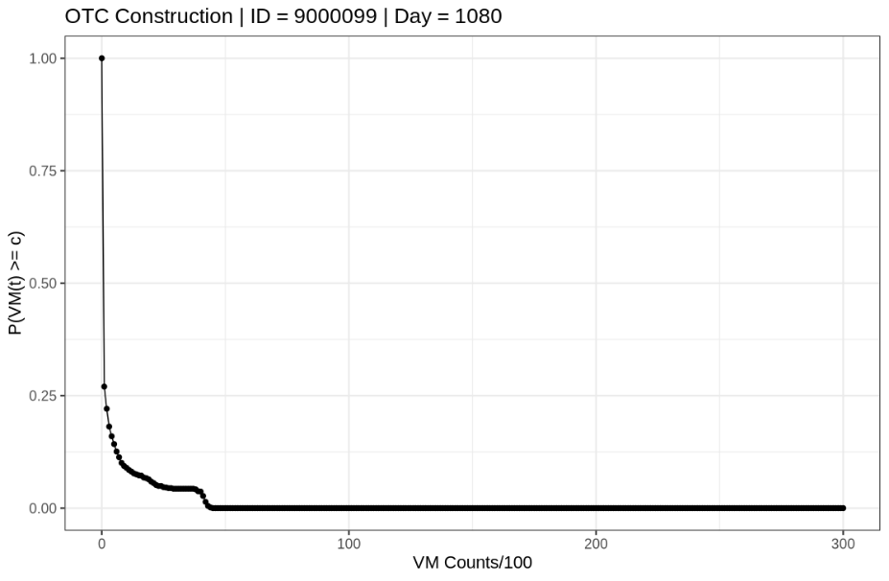
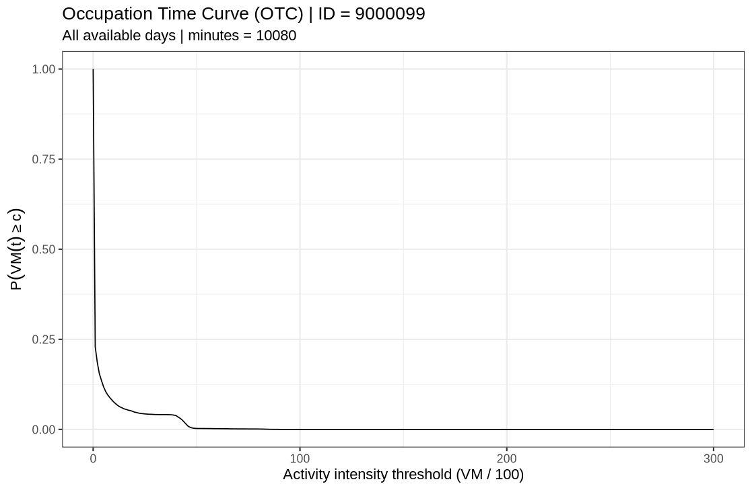
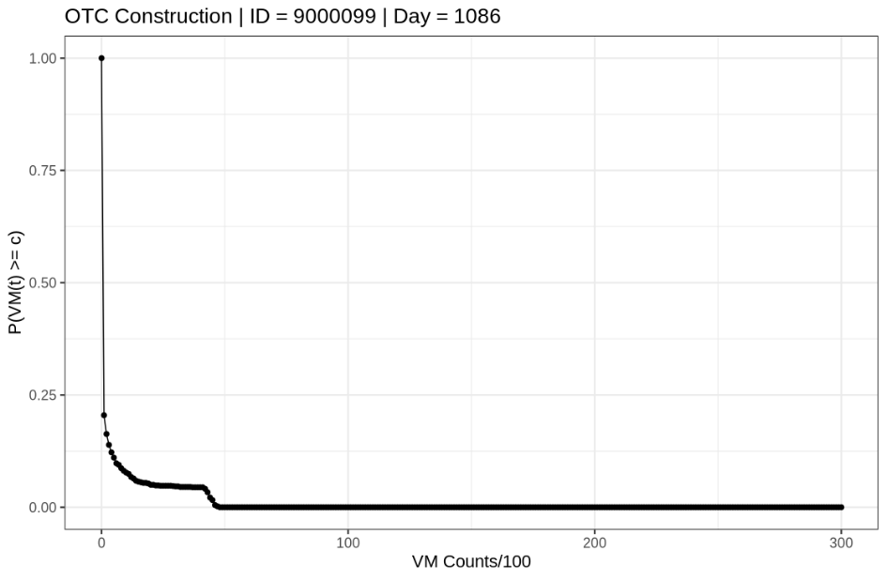

Part 3：Current Step
From minute-level activity time series:
$VM\left(t\right), t=1,…,T$
to a distributional summary: Occupation Time Curve (OTC): $OTC(c)=P\{VM(t)≥c\}$
Transform to OTC
Why did this?
The (OTC) intentionally ignores the temporal ordering of VM(t).
Focuses on a single question: Over the entire observation period, what proportion of time does an individual spend at or above a given activity intensity level?
Page 8

Slide 9
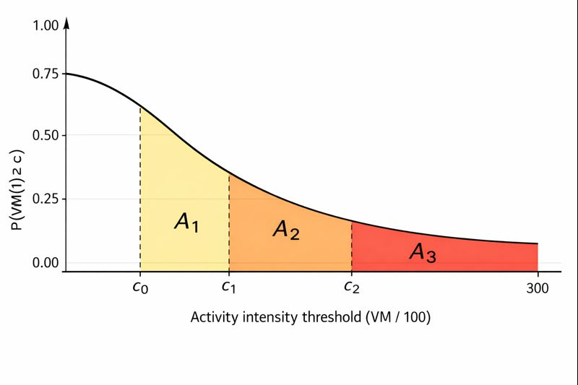

Part 3：Current Step
Establish AUC
We partition the activity intensity axis into intervals: $0=c_{0}<c_{1}<⋯<c_{J}$, and define, for each interval, $A_{j}=\int_{c_{j−1}}^{c_{j}}{OTC(c) dc,}j=1,…,J$.
Example to use AUC:
Outcome $Y_{i}$: BMI of subject $i$
Covariates (from activity data): $\left(A_{i1},A_{i2},…,A_{iJ}\right)$, where: $A_{ij}$= AUC for subject $i$ in intensity interval $j$, and fit the model: $Y_{i}=β_{0}+\sum_{j=1}^{J}{β_{j}}A_{ij}+ε_{i}$.
If $β_{j}>0$: Spending more time in intensity range $j$is associated with higher BMI.
If $β_{j}<0$: Spending more time in intensity range $j$is associated with lower BMI
Why did this?
By splitting the OTC into shaded areas, we convert a curve into a set of numerical features.
OTC provides a stable functional summary.
AUC converts it into a model-ready representation.
Page 9

Slide 10
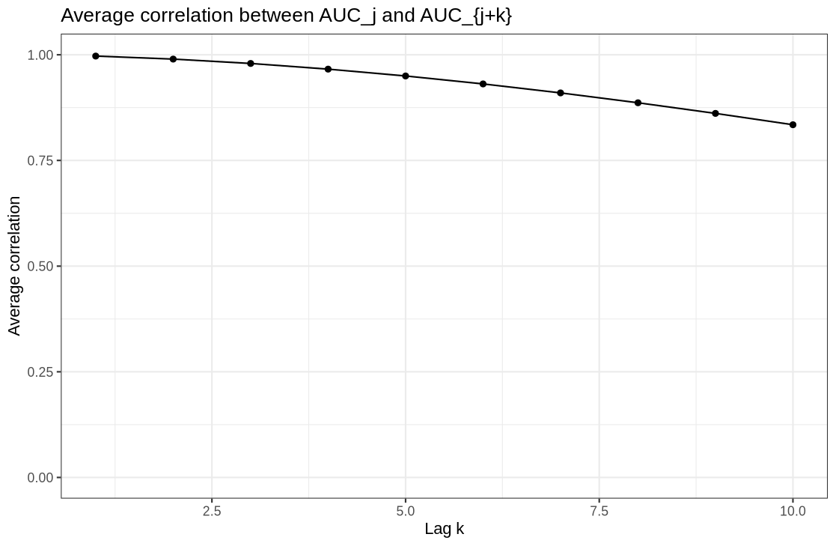
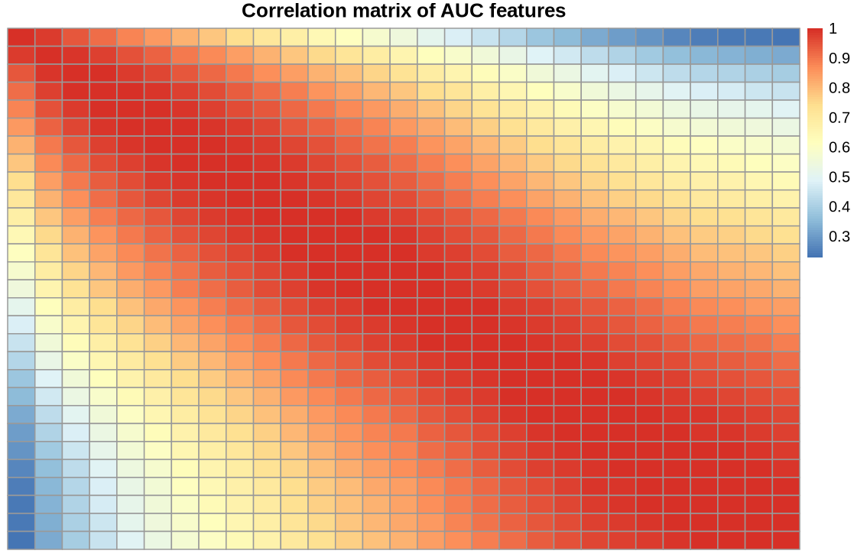
Part 3：Current Step
Correlation Diagnostics
Here we check how similar the AUC features are to each other.
Strong correlation alone is not sufficient justification to apply fused lasso or standard regression at this stage.
L0 regularization directly controls how many features are selected, and mixed-integer optimization allows us to solve this selection problem exactly.
Page 10

Slide 11
Part 4：Future Arrange
Plans for next steps
Identify an appropriate outcome variable (Y)
1
Apply L0 + MIO for feature selection
2
Examine and interpret selected features
3
Page 11

Slide 12
The University of Toronto
DALLA Lana School of Public Health
Thanks For Listening
Presenter：Xiankai Yang
Instructor：Osvaldo Espin Garcia
Page 12

